Slide 1

LIRI Node App
Joseph Wiliamson

Slide 2
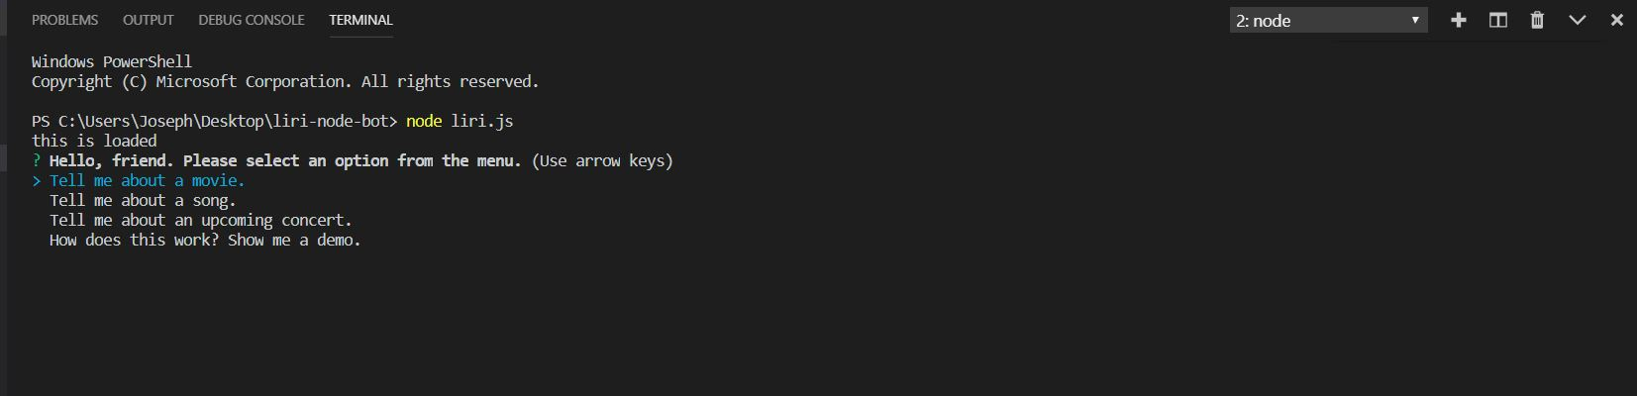
I used the Inquirer module to give users a menu. I wanted the app to be more intuitive and user friendly - something that anyone could really sit down and use.

Slide 3
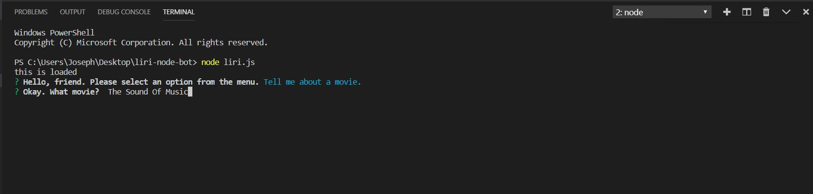
After utilizing a List for the first menu, I went with a prompt here to let the user input their search. This runs through the OMDB API.

Slide 4
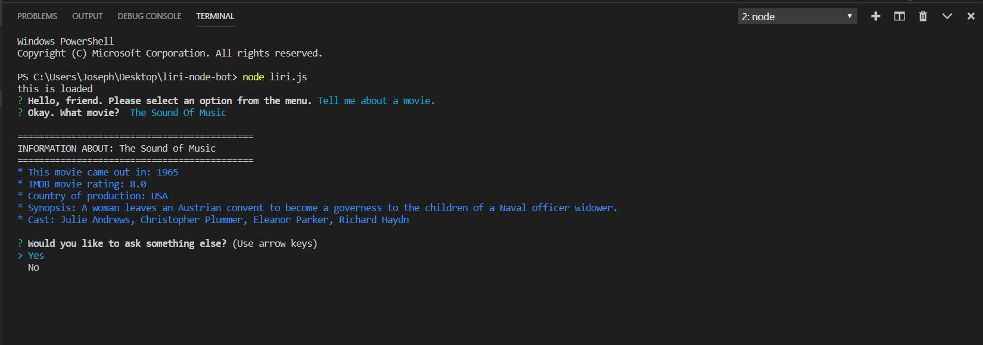
The console log is formatted for easy reading. I used the Chalk node module to allow the color change. Each selection is followed by a choice to ask another question. If the user refuses...

Slide 5
They are given a friendly farewell. The program must then be re-initialized from the command line.

Slide 6
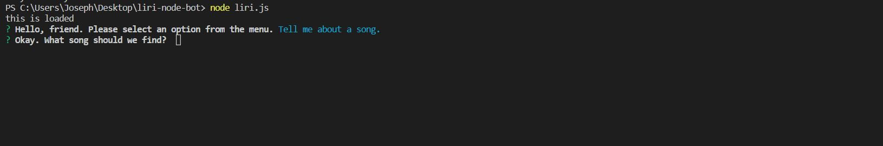
Here we’ve reloaded with the Song selection. Again, the user is prompted to enter a song.

Slide 7
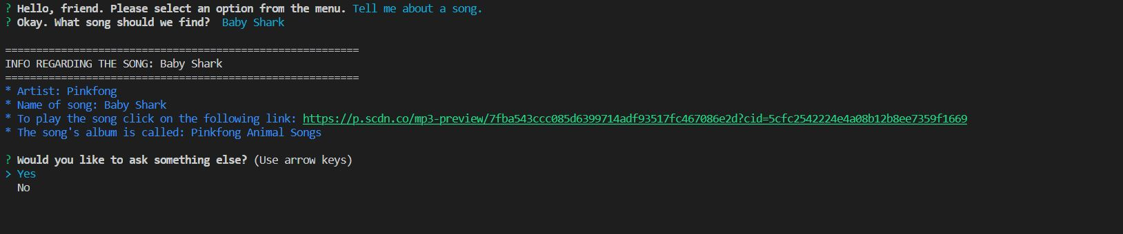
The song comes from the Spotify API. I wanted to highlight the link a different color to indicate its ‘clickibility’. This time, we’ll select Yes when prompted if we need anything else.

Slide 8
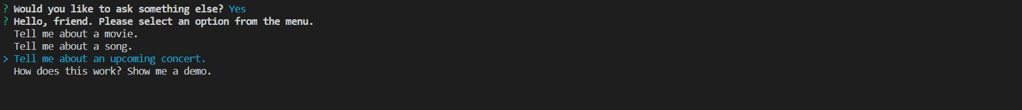
This selection relaunches liri.js and brings up our initial menu. This time we’ll look at the concert option.

Slide 9
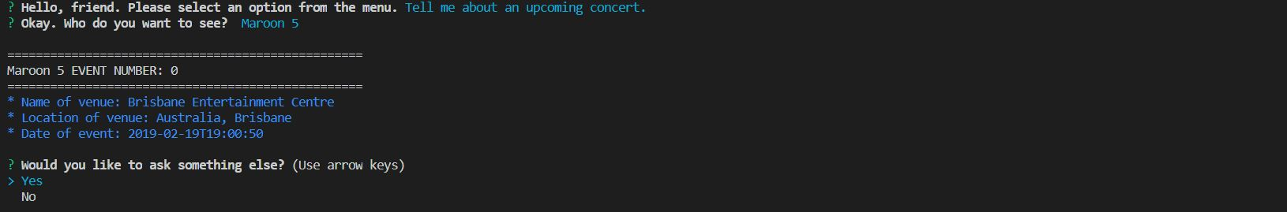
\
This time the users input is taken and put through the Bands In Town app.

Slide 10
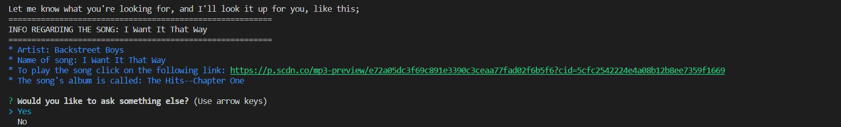
Finally, the ‘Demo’ selection runs the Spotify search on text listed in the ‘random.txt’ file. Using the fs read command I left a variable on the page which is read by the program to fill in an empty variable in the Query URL.

Slide 11
Thank you!

